Slide 1
Volume and Capacity
EQ: How do I solve the volume and capacity of objects?

Slide 2
Quick write
We have learnt a lot of new skills in volume, surface area and capacity.
Spend the next two minutes writing all you can remember about the topics?

Slide 3
Fermi Question
A Farmer wants to put his hay into his barn. The barn is 10m wide, 20 metres long and 15 metres high. How many hay piles can he fit into his barn?

Slide 4
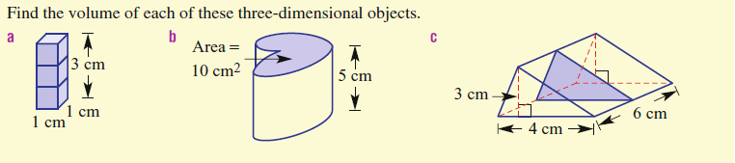
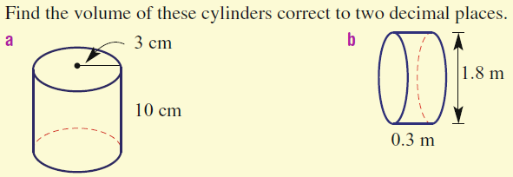
Volume Review

Slide 5
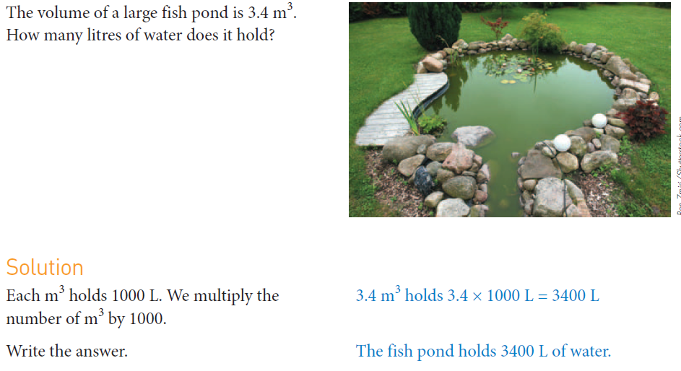

Slide 6
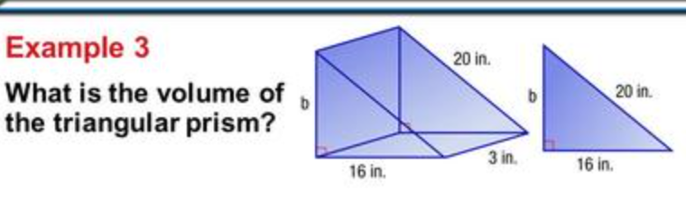

Slide 7
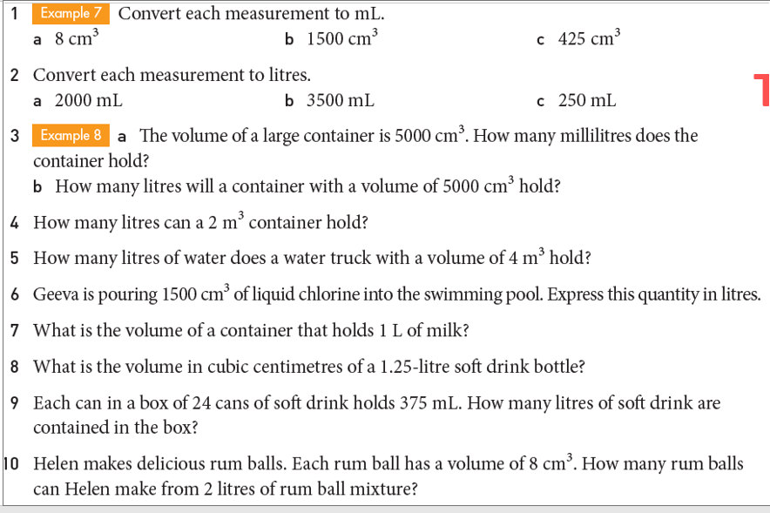

Slide 8
